Slide 2
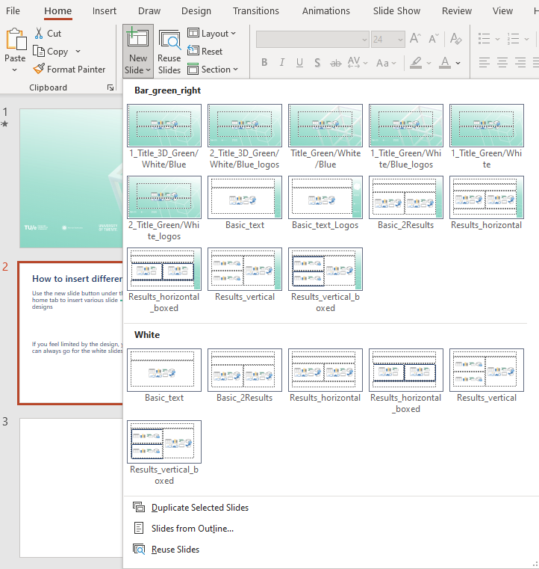
How to insert different MCEC slides
Click on “New Slide” under the home tab to find various slide designs
If you feel limited by the banner, you can always go for the white slides

